Slide 1

Two-factor Authentication: Is the World Ready? Quantifying 2FA Adoption
Thanasis Petsas, Giorgos Tsirantonakis,
Elias Athanasopoulos, Sotiris Ioannidis
{petsas, tsirant, elathan, sotiris}@ics.forth.gr

Slide 2


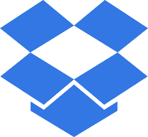





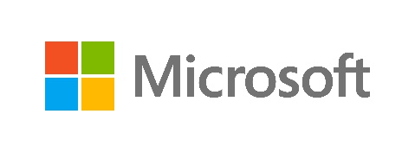


Need for Better Authentication
Plethora of services
Myriads of passwords for a user to remember
Password recycling
Solutions:
Password Managers
Manages user’s passwords
Supports encryption and protection
SSO (Single sign on)
A single username and password for many accounts
It provides automation
The user’s password are not saved anywhere making a database leak impossible
→ Two Factor Authentication

Slide 3
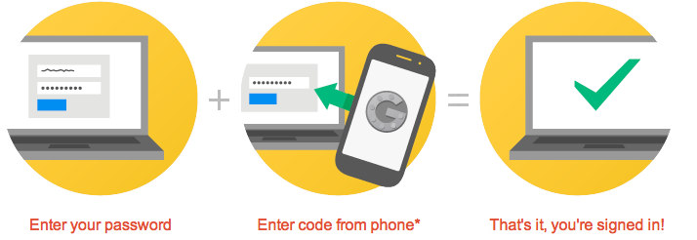
Two Factor Authentication (2FA)
Additional communication channel used during authentication
How 2FA works
Why use 2FA
Provides Protection
phising
leaking a server’s password database
Even if the attacker obtains the victim’s password, he still needs the 2nd factor

Slide 4
Is 2FA Deployed by Online Services?
Increased number of services adopting 2FA through time
Google was from the first to adopt it
Are the users willing to adopt it?

Slide 5
This Study
First attempt to measure 2FA adoption by the users
Study of password reminders from a privacy perspective

Slide 6
Methodology – step by step (1/4)

Slide 7
Methodology – step by step (2/4)

Slide 8
Methodology – step by step (3/4)

Slide 9
Methodology – step by step (4/4)

Slide 10

Methodology – Overview
CAPTCHA
Google’s password reminder reveals the verification method of a user
We used a dataset of leaked Gmail accounts
Made the process automatic with Casperjs
We used distributed networks to reduce the appearance of Captcha

Slide 11








Browser Enhances
In order to mimic the behavior of a real user and reduce the ratio of Captcha
Random delay between steps
Use of Fake Referer
Use random user agent among 80 most common
Clear all cookies for each request

Slide 12
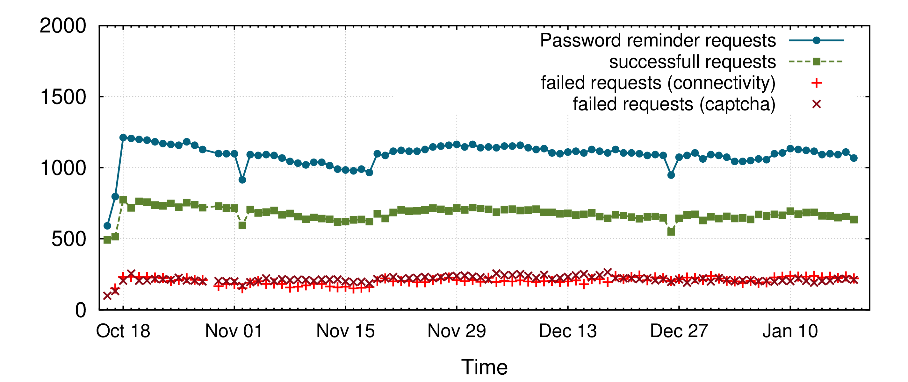
Requests Made Through PlanetLab
Planetlab is a group of computer hosts shared by academic institutions for distributed experiments
1091 average daily requests from Planetlab
675 average successful

Slide 13
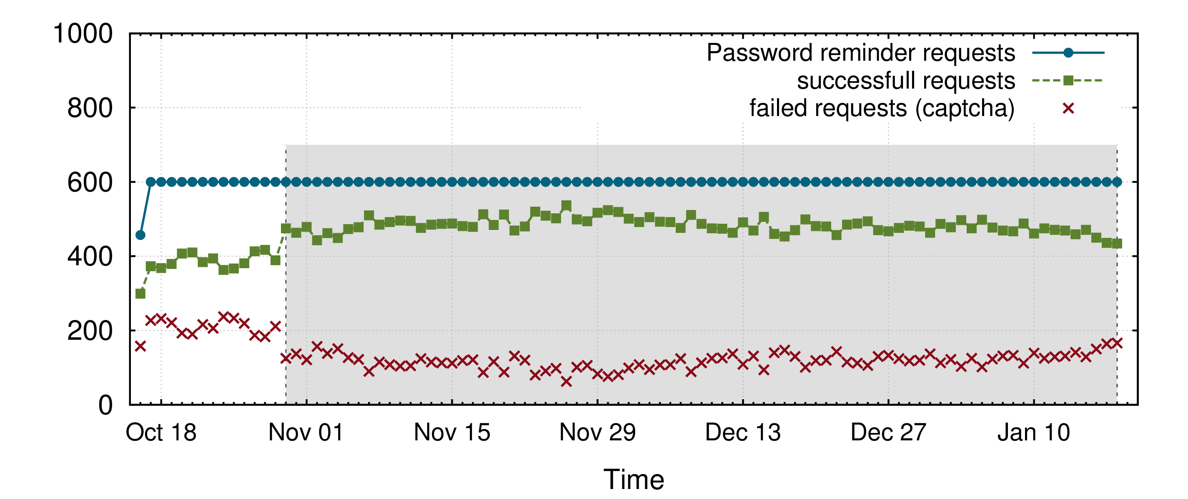
Requests Made Through TOR
Tor is an anonymity network with hosts around the world
600 average daily requests from Tor
468 average successful
Tor enhanced version

Slide 14
TOR Client Enhances
1st version
NEWNYM signal to tor client
Generated new circuit
Enhanced version
Visited whatsmyip.org
Updated configuration file
HUP signal
Captcha rate was decreased by 19.8%

Slide 15

Ethics
We tested our study in dummy accounts
We made sure the user was not affected or contacted at all
We do not complete the password remind process
If a request fails we do not recheck it the same day
Google receives over 3,5 million password reminder requests per day, we have a limit at 1800
We do not store any user data

Slide 16
Results
We analyzed over 100k accounts
2FA is only used by less than 6,5% of the users
68% of the users have registered their phone number to Google

Slide 17
2FA Sustainability
Rechecked accounts that used TFA
Recheck interval is the time passed between the two checks

Slide 18
Is 2FA Exposed in Other Services?
2FA Exposed in Microsoft and Apple
Microsoft always requires a Captcha preventing crawlers

Slide 19
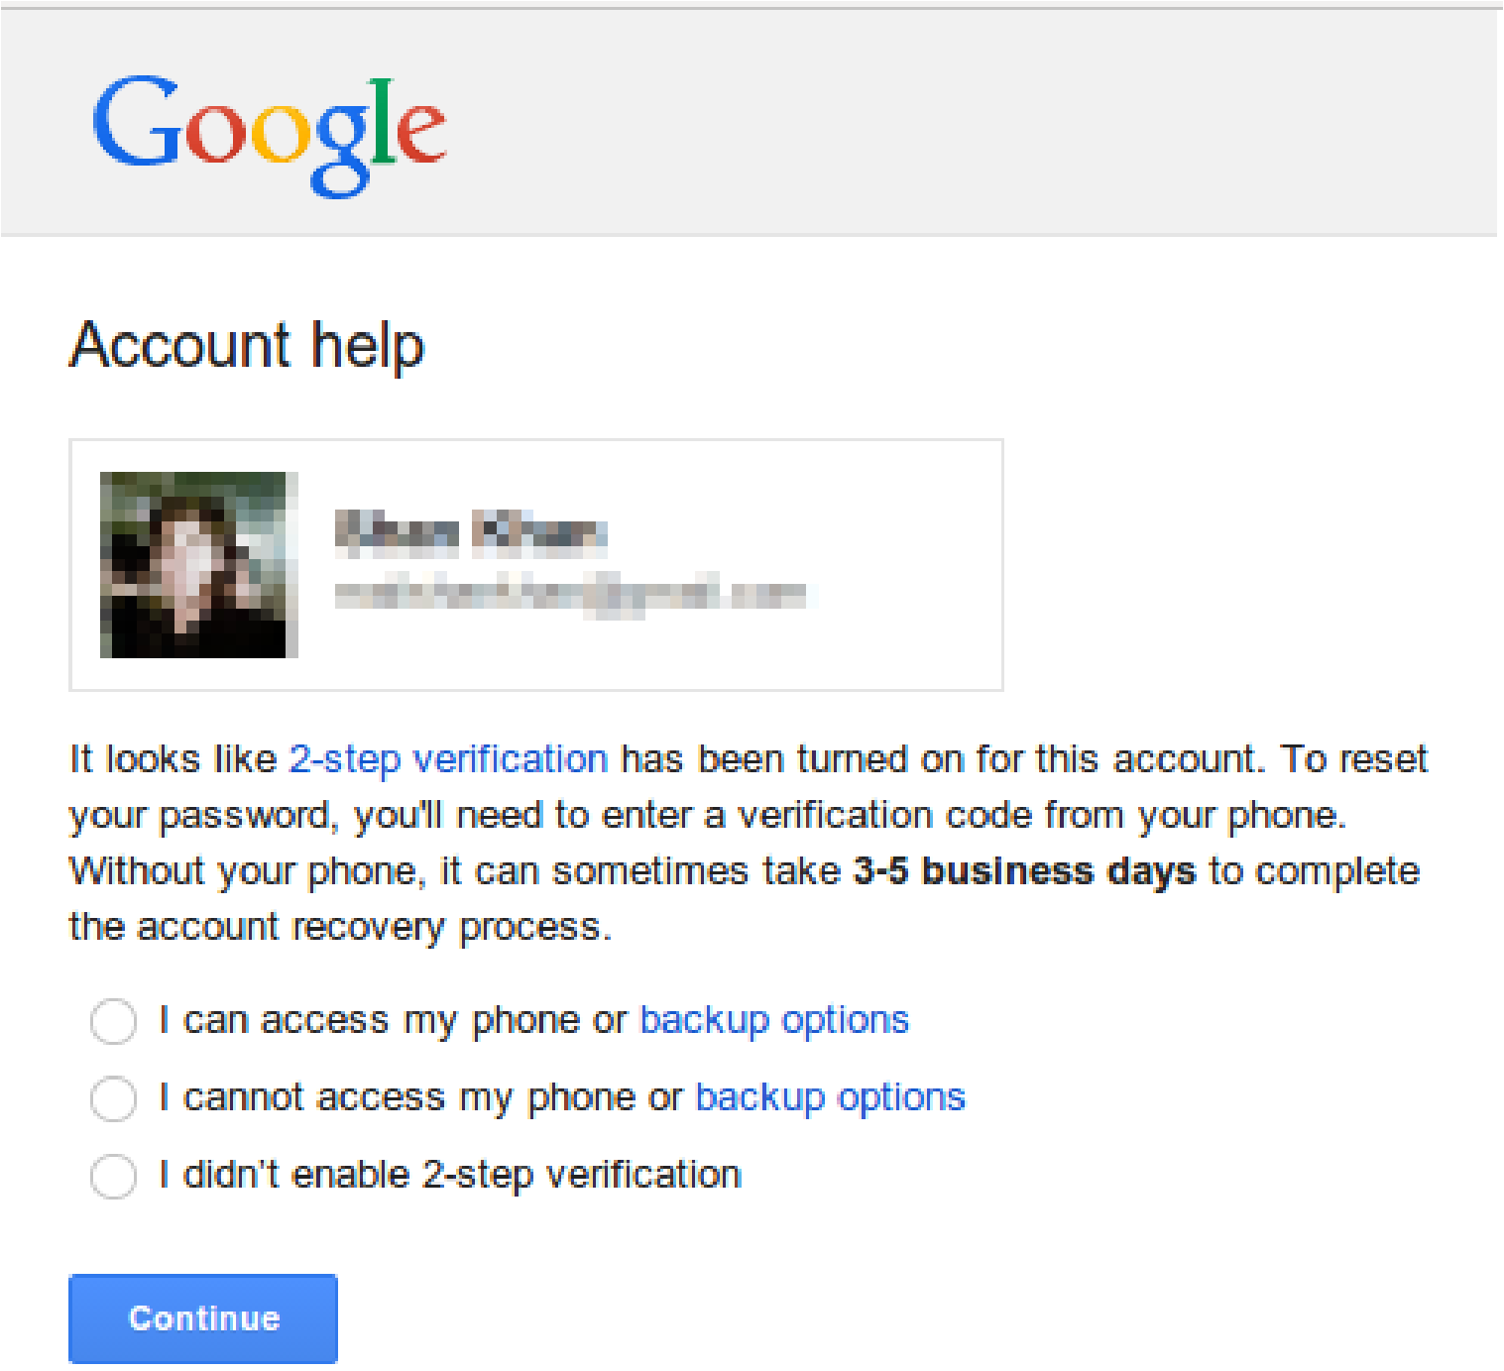
User Data Exposed
58.15% of the users used a photograph
Full name revealed
3 last numbers of phone number
3 first characters of the secondary e-mail and it’s exact size

Slide 20
Improving Google’s password reminder
Use of Captcha to prevent crawlers
Do not show 2FA information
Remove sensitive user information

Slide 21
Conclusion
Measured adoption of 2FA in the wild
Tested over 100k accounts
2FA has been adopted by no more that 6,5% of the users
Revealed privacy issues in the password-reminder process
Sensitive information of users is exposed (e.g name, surname)
Photograph of users found exposed for more than half of the accounts tested
Suggestions to improve password-reminder software

